Slide 1
#4 Managing Your Cash and Savings

Slide 2

Role of Cash Management in Personal Financial Planning
Cash Management -- routine, day-to-day use of liquid assets
Cash and other assets that can be converted easily into cash with little or no loss in value.

Slide 3

Examples of Liquid Assets
Cash
Checking Accounts
Savings Accounts
Money Market Deposit Accounts
Money Market Mutual Funds
Certificates of Deposits (CDs)
U.S. Treasury Bills (T-bills)
U.S. Savings Bonds (EEs)

Slide 4
Today’s Financial Services Marketplace
Financial Products
checking and savings accounts
credit cards
loans and mortgages
insurance
mutual funds
Financial Services
financial planning
tax preparation
securities brokerage
real estate
trusts
estate planning

Slide 5
Types of Financial Institutions
Depository
Commercial Banks
Savings & Loans
Savings Banks
Credit Unions
Nondepository
Stock Brokerage Firms
Mutual Funds
Life Insurance Companies
Finance Companies

Slide 6
Types of Depository Financial Institutions Part 1
Commercial Banks
Largest type of traditional financial institution
Offer full array of financial services
Only financial institution to offer noninterest-paying checking accounts

Slide 7
Types of Depository Financial Institutions Part 2
Savings & Loan Associations (S&Ls)
Offer services similar to commercial banks
May pay slightly more on savings deposits
Channel depositors’ savings into mortgage loans

Slide 8
Types of Depository Financial Institutions Part 3
Savings Banks
Located primarily in New England
Offer interest-paying checking accounts
Rates similar to Savings & Loan Association
Most are mutual associations

Slide 9
Types of Depository Financial Institutions Part 4
Credit Unions
Provide financial products and services to people with a common tie
Nonprofit, member-owned financial cooperative
Interest rates higher than other institutions

Slide 10
How Safe is Your Money?
Most financial institutions are federally insured
Federal Deposit Insurance Corporation (FDIC) insures accounts at banks, savings banks, and S&Ls
National Credit Union Administration (NCUA) insures accounts at credit unions
Frank-Dodd Wall Street Reform and Consumer Protection Act of 2010 increased maximum deposit insurance from $100,000 to $250,000.

Slide 11

Checking and Savings Accounts
Checking Account = Demand Deposit
If sufficient funds, banks must pay amount of check or ATM withdrawal
Savings Account = Time Deposit
Expected to remain on deposit for a longer time period

Slide 12
Types of Checking Accounts
Regular checking accounts
Offered by commercial banks
Pay no interest
Interest-bearing checking accounts
Include NOW, share draft, and money market deposit accounts
Offered by banks, savings banks, S&Ls, and credit unions

Slide 13
Interest Paying Checking Accounts
NOW Accounts - Interest paid, may have minimum balance
Money Market Deposit Accounts (MMDAs)- Convenient, safe, federally insured
Money Market Mutual Funds (MMMFs)- Pool investors’ funds to purchase high-return, short-term marketable securities

Slide 14
Asset Management Accounts
Comprehensive deposit account combining checking, investing, and borrowing activities offered by brokerage firms and mutual funds
Account usually includes MMDA with unlimited free checking, debit card, use of ATM, and loans

Slide 15

Electronic Banking Services
Electronic Funds Transfer Systems (EFTS) offer:
ATM service
Debit cards linked to checking account
Pre-authorized deposits and payments
Banking by phone
Online banking and bill payment services

Slide 16

Electronic Funds Transfer Act of 1978
Regulates EFTS services
Errors must be reported within 60 days
Limit losses by immediately reporting theft, loss, or unauthorized use of credit card or account!

Slide 17
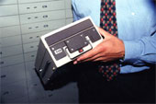
Other Bank Services
Safe-deposit boxes – rented drawer in a bank’s vault.
Trust Services - provide investment and estate planning advice

Slide 18
Opening and Using a Checking Account
Consider costs
Individual or joint account
Checking account procedures
Overdrafts
Stopping payment

Slide 19
Special Types of Checks
Special checks guarantee payment
Cashier’s Check - drawn on the bank
Traveler’s Check - used for making purchases worldwide
Certified Check - drawn on account but guaranteed by bank

Slide 20

Establishing A Savings Program
Create emergency fund
Set aside funds for financial goals
Utilize direct deposits and automatic transfers
Make suitable choices based on goals and time horizon
On payday - deposit money into savings account, using check or debit card

Slide 21
Earning Interest on Your Money
Simple Interest interest paid only on initial deposit
Compound Interest interest paid at set intervals and added back to principal

Slide 22
Earning Interest on Your Money (continued)
Nominal rate - named or stated interest rate
Effective rate - annual rate of return actually earned
If interest is compounded more frequently than once a year, the effective rate will be greater than the nominal rate of interest

Slide 23
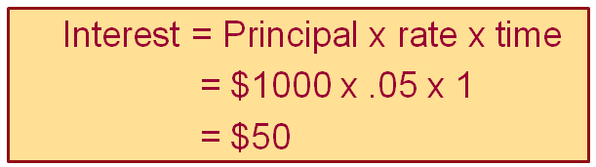
How Is Interest Calculated? Part 1
If simple interest is used, there is no compounding

Slide 24

How Is Interest Calculated? Part 2
If compound interest is used and the compounding occurs semiannually then
1st 6 months' interest:
2nd 6 months' interest: +
Total annual interest = $50.63

Slide 25
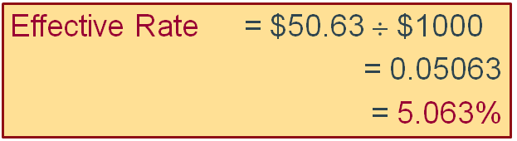
How Is Interest Calculated? Part 3
Nominal rate = 5% …but….
Effective rate = 5.063%

Slide 26


How Much Interest Will You Earn?
Amount of interest earned depends on
Frequency of compounding
Balance on which interest is paid
Interest rate paid
Time value of money concepts are used in compounding to find interest earned

Slide 27
A Variety of Ways to Save
Certificates of Deposit (CDs)
Funds remain on account for a given time period
Early withdrawals incur an interest penalty
U.S. Treasury Bills
Debt securities issued by U.S. Treasury
Sold at a discount; $1000 minimum
Mature in 1 year or less

Slide 28

A Variety of Ways to Save (continued)
Series EE Bonds
Purchased at a discount
Accrual-type security with interest paid when cashed in
Exempt from state, local taxes
New bonds must be held 1 year
Income taxes may be avoided if redeemed for educational purposes

